Slide 1


SAP BTP Training
Cloud Foundry Training

Slide 2

DISCLAIMER
The training content and delivery of this presentation is confidential, and cannot be recorded, or copied and distributed to any third party, without the written consent of Anubhav Trainings

Slide 3

LEARNING OBJECTIVES
Working with UI
What is SAP UI5?
How to create simple UI5 page
Test UI5 page
Working with MVC
Create First View and Controller
--BREAK--
Integrate
Integrate Service
Create Promise API with JS
Perform CURD using UI
Test Application locally
Understand Backing service
Start Postgre backing service

Slide 4
What is SAP UI5?
SAP UI5 is a framework which is built on open standards (HTML5,CSS,JS,iQuery) to create Responsive Web Application.
Framework – collection of libraries
Library – Collection of classes
Class – Collection of Methods, Attributes, Events and Aggregations
Where we do we check documentation on SAP UI5?
SAP UI5 SDK – https://sapui5.hana.ondemand.com

Slide 5
What is SAP UI5?
SAP UI5 is a framework which is built on open standards (HTML5,CSS,JS,iQuery) to create Responsive Web Application.
Framework – collection of libraries
Library – Collection of classes
Class – Collection of Methods, Attributes, Events and Aggregations
Where we do we check documentation on SAP UI5?
SAP UI5 SDK – https://sapui5.hana.ondemand.com

Slide 6
Working with MVC
What is the development methodology used in developing?
MVC architecture is used in software industry to build UI applications.
Model – We keep all our application data into the model
View – The user interface with which user will interact with our application
Controller – Which is where our application logic is being kept
Event handlers
Controller
(Processing)
events
View (I/O)
Data binding
Model
(Data)

Slide 7
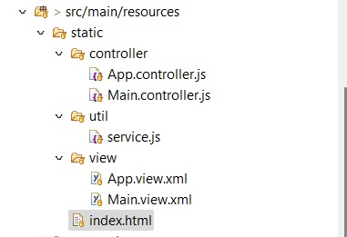
HANDS-ON: Create First MVC Application
Create your first MVC application with display data

Slide 8
HANDS-ON: Integrate with service API - Promises
Controller
Service.js
Vendor API
View
Asynchronous programming
https://www.youtube.com/watch?v=zY6gnfxgb9I
https://www.youtube.com/watch?v=oxxOPqoezjA

Slide 9
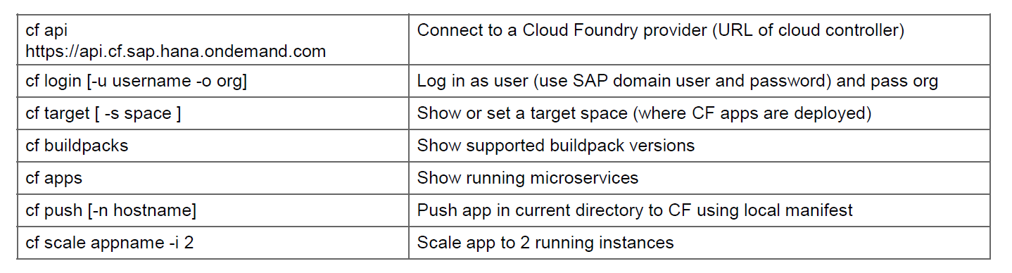
HANDS-ON: DEPLOY CURDQ APP IN CF
Add manifest.yml file to the app
Deploy the app to CF
---
applications:
- name: dbboot
random-route: true
memory: 1024M
path: /target/02dbboot-0.0.1-SNAPSHOT.war
buildpacks:
- java_buildpack
Solution:
https://github.com/soyuztechnologies/02dbboot.git

Slide 10
Backing Service in CF
A backing service in CF is just a reusable service. We will use these backing service for different purpose
DB as a service – PosgreSQL, SAP HANA, SAP HANA HDI, Mongo, Redis
Queue – Rabbit MQ, Kafka
Authentication manager – UAA service
Connectivity Service
Our application will bind to these services and use them out-of-box. As a app developer we don’t have to worry about running most of these functionalities own our own.
Steps:
Start a new backing service instance
In order to access these backing service we need add a services entry in our app’s manifest.yml file
The cloud foundry also provides Environment variables, which we can use to connect to these backing service. This way its fully flexible. To check these environment variables we can use command cf env <appname>
Advantage:
Never need to hardcode our db credentials anywhere, the app will look for it and connects to it
Scale backing service individual
Complete management of backing service using CF cockpit or command line
Take care of auto binding in D, Q and Production
www.anubhavtrainings.com

Slide 11
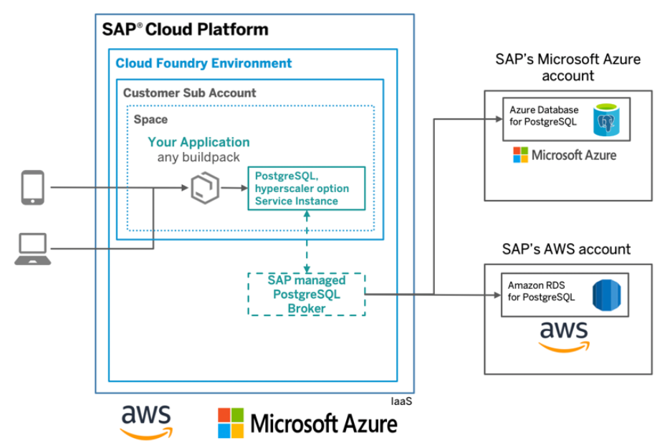
HANDS-ON: Setup Postgre Backing service in CF
SAP BTP

Slide 12

Summarize
LET’S SUMMARISE!

Slide 13

Summarize
End of Day 5

Slide 15


We’re committed to empower you to be
#FutureReady
through powerful training solutions.
We build the workforce of the future.
250+
Corporate Clients
30,000+
Learners Trained
25000+
Learners Placed
FREE WEBINARS
Sign up for free webinars with industry experts every fortnight!
Enroll Now!
Contact us today!
https://anubhavtrainings.com

